Slide 1
Genomic dissections of inflammatory proteins
A presentation at the CEU
on behalf of the SCALLOP/INF1 consortium
https://jinghuazhao.github.io/INF/
30/5/2019

Slide 2
Introduction
There is a strong motivation to integrate genomic, proteomic and phenotypic data for biological and clinical insights.
This study involves 12 genomewide association studies in SCALLOP consortium using Olink assay of 91 proteins for study of inflammation in immune response and/or pathological processes and diseases.
The aim is to identify protein quantitative trait loci (pQTLs) and assess their biological and/or clinical significance.
Genz et al (2016), JAMA 315:2532-41; Niewczas MA, et al. (2019). Nat Med; Sun B, et al (2018). Nature 558: 73-9.

Slide 3
Study information
Study name | Study design |  | Sample size
NSPHS |  | population study Sweden |  | 866
MadCam |  | ulcerative colitis |  | 185
STABILITY |  | atherosclerosis |  | 2,951
STANLEY swe6 |  | bipolar, depression |  | 300
STANLEY lah1 |  | bipolar, depression |  | 344
BioFinder |  | dementia |  | 1,496
RECOMBINE |  | rheumatoid arthritis |  | 860
Estonian Biobank |  | population study Estonia |  | 487
INTERVAL |  | blood donors England |  | 4,902
KORA F4 |  | population study Germany |  | 1,064
ORCADES |  | population isolate Orkney |  | 981
VIS |  | population isolate Croatia |  | 899
Total |  |  |  | 15,335

Slide 4
Olink Proximity Extension Assay (PEA) technology
Multiplex immunoassays that measure 92 proteins across 96 samples simultaneously using only one microliter of serum, plasma, etc.
A pair of oligonucleotide-label(l)ed antibodies (“probes”) are allowed to pair-wise bind to the target protein present in the sample in a homogeneous assay, with no need for washing. When the two probes are in close proximity, a new PCR target sequence is formed by a proximity-dependent DNA polymerization event. The resulting sequence is subsequently detected and quantified using standard real-time PCR.
https://www.olink.com/data-you-can-trust/technology/

Slide 5
Statistical analysis
Association model. proteins ~ genotypes + sex + age + PCs using rank-based inverse normal transformation on protein and additive models of imputed genotypes from 1000Genomes, UK10K+1000Genomes or HRC imputation panels. For KORA, PC1-PC5 were derived from a panel of LD-pruned SNPs, excluding six related individuals.
Meta-analysis. Done iteratively on regression betas without GC correction on individual studies with N>=10 for all variants only to ensure data availability.
Signal identification and classification. Based on summary statistics.
Annotation. Based on PhenoScanner to be followed by other approaches.
Yengo L, et al. (2018). Hum Mol Genet 27:3641–3649

Slide 6
Quality control as with IFN.gamma
The majority of sumstats for each protein were satisfactory.
However, there were a small number (~20) of problematic proteins according to QCGWAS, with which Manhattan plots were produced for each protein from each cohort. It appeared that the total number was a function of MAF, from ~20 at 0.03 to 3 at 0.1.
The QC over IFN.gamma is given below as example.

Slide 7


Manhattan (L) and Q-Q (R) plots

Slide 8
Above-LLOD% and exclusion
It turned out
An attempt was made in the study by using llod/2.
Manhattan plots (excessive number of significant hits) closely related to this.
Although higher MAF cutoffs could did away with busy Manhattan plots, it is unusual to do so and the associate proteins with low >LLOD% were discarded.

Slide 9
Busy Manhattan plots and above-LLOD%
Protein | % | Protein (continued) | % (continued)
L.15RA | 0.841 | IL13 | 0.062
ST1A1 | 0.808 | IL.20RA | 0.057
MCP.3 | 0.804 | IL.24 | 0.051
FGF.5 | 0.652 | IL.20 | 0.046
AXIN1 | 0.425 | NRTN | 0.039
IL.17A | 0.380 | ARTN | 0.035
IL.17C | 0.369 | IL.1.alpha | 0.025
IL4 | 0.171 | IL.2RB | 0.023
IL5 | 0.162 | IL33 | 0.014
IL.10RA | 0.149 | IFN.gamma | 0.007
TNF | 0.096 | TSLP | 0.005
LIF | 0.064 | IL.22.RA1 | 0.003

Slide 10


IFN.gamma from >1,000 signals (L) to none (R)

Slide 11
Results
Manhattan, Q-Q, LocusZoom (cis regions) and forest plots.
Independent/near-independent (primary+secondary) signals and their cis/trans classification/plot.
OPG as positive control through PhenoScanner v1.1 (with chr:pos input), v2 (with rsid input) for INF1 as a whole and by proteins. Additional results on IBD, rheumatoid arthritis.
Parallel effort on coloc(alisation)-type analysis.

Slide 12


Manhattan (L) and Q-Q plots (R) for OPG

Slide 13

Regional plot (OPG, chr8)

Slide 14


Slide 15


Slide 16
Comparison
The chromosome 8 locus here is ~200kb upstream.
Quoting Kwan JSH, et al. (2014). Hum Mol Genet 23(24): 6684—93:
“The most significant SNP in this locus (rs704) encodes a possibly damaging (predicted by PolyPhen2) missense mutation in the VTN gene. Moreover, eQTL analyses showed that the SNP was significantly associated with TMEM199 expression in pancreas and whole bone, as well as TMEM97 expression in whole blood. The low RegulomeDB score of the SNP also suggested that the SNP has important regulatory functions”.
.

Slide 17

375 (SNP+indel) Signals
355 primary+20 secondary signals.
Proteins |  | Signals
only cis pQTLs |  | 12
only trans pQTLs |  | 14
both cis and trans |  | 43
no pQTL |  | 22
220 cis/155 trans signals, excluding 35 signals from regions in high LD.

Slide 18
Seven genomic regions have pQTLs for IL12B. The cis-acting pQTL near the IL12B gene* is a GWAS hit for inflammatory bowel disease.
IL12B
*sentinel pQTL variant lies -39kb of IL12B
LPP
BHLHE40
RAD51B
MHC
SH2B3
TRAF3

Slide 19
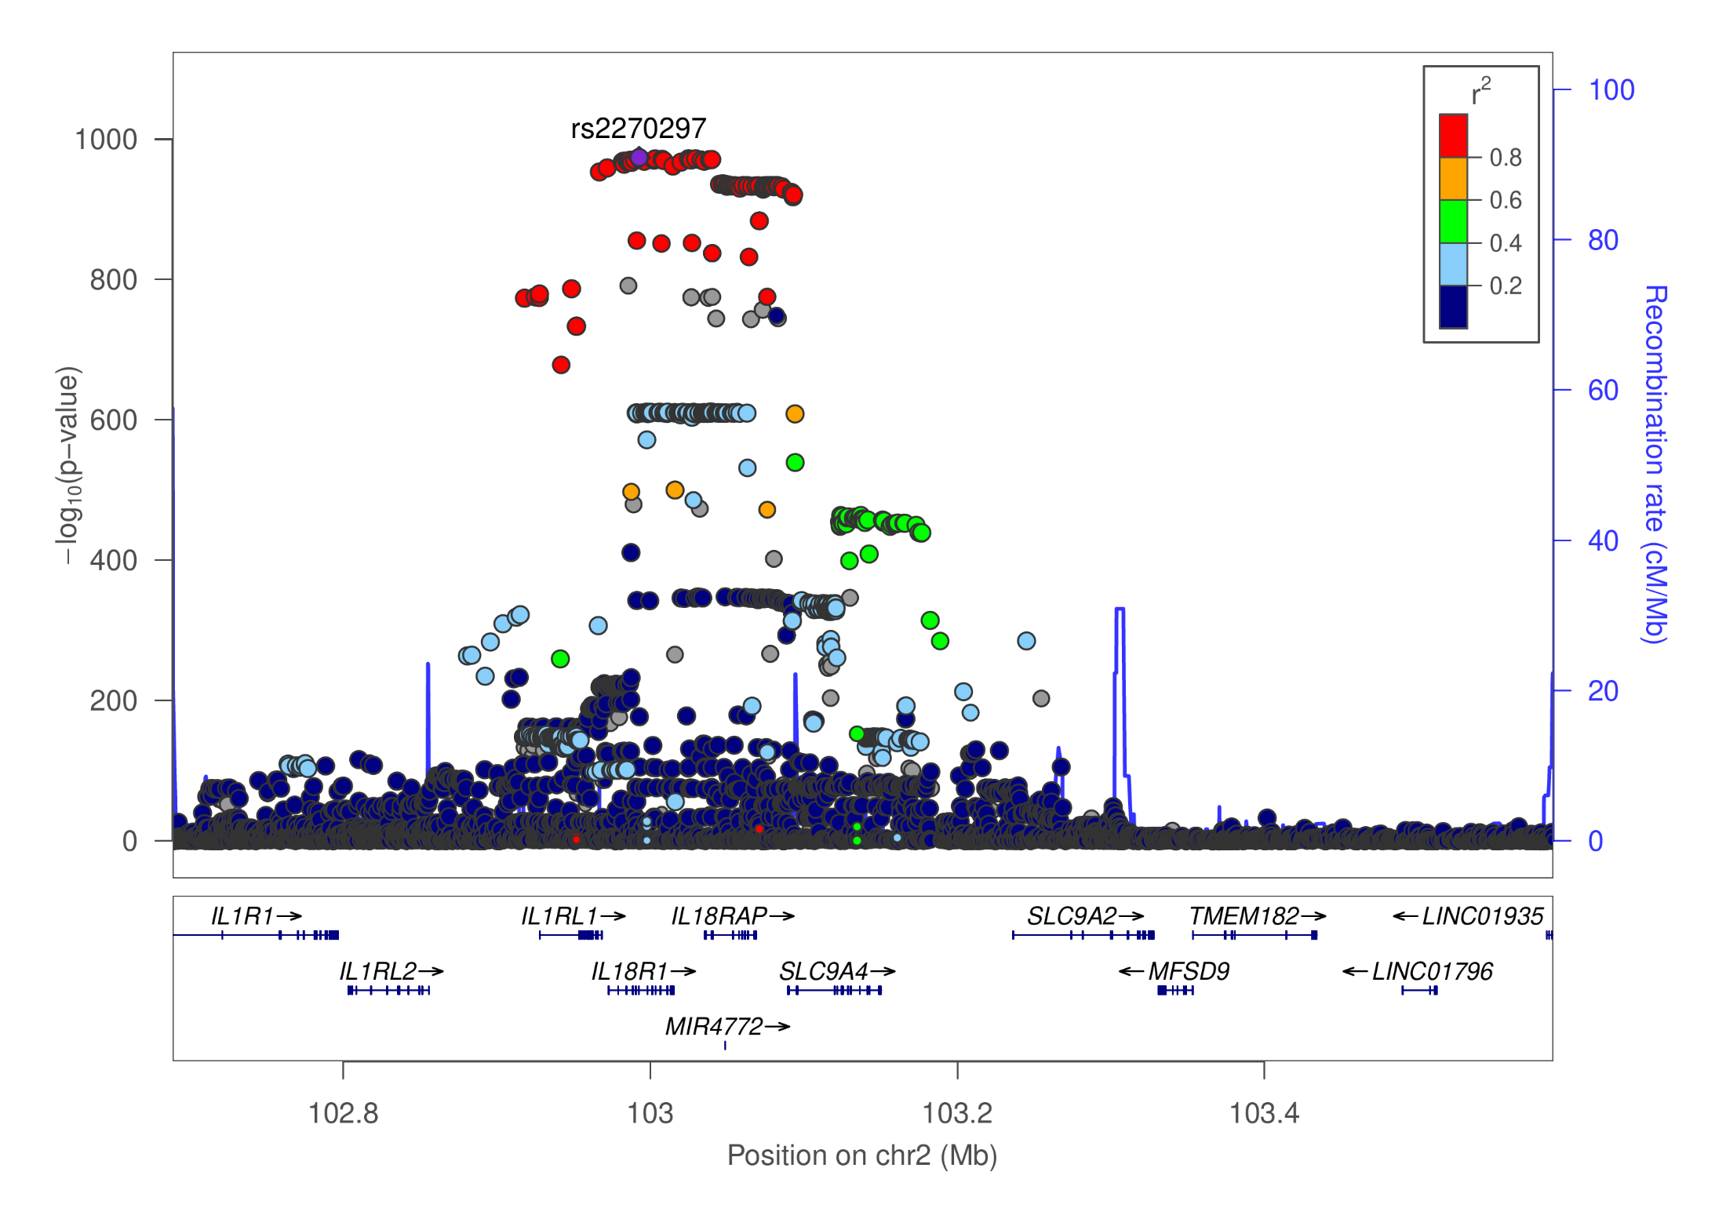
IL.18R1 (chr2:02688765−103588215), 899,450bp

Slide 20

λGC

Slide 21


Effect size -- MAF (L) and b/bJ (R, r=0.93)

Slide 22
Signal identification
GWAS summary statistics contain many enriched pQTLs and proved useful for many downstream analyses.
Fundamentally important genomewide significant signals are often in strong LD with others and conditionally significant.
The uncertainty in dealing with LD can be seen that among a predefined 1,703 approximately independent (AI) autosomal regions, 36, 300 and 1,701 are 250kb, 500kb and 10mb apart, respectively, giving 1,672 regions after excluding regions in high LD such as HLA.

Slide 23
in silico experiments
Parameters. 1KG (LocusZoom 1.4) and UK10K+1KG as LD references; GCTA –cojo-collinear 0, 0.1, 0.9 –cojo-wind 500, 10000; PLINK –clump-r2 0, 0.1 –clump-kb 500, 1000; Regions in high LD; SNPs, +indels; Genomewide slide windows versus the use of AILD blocks.
Major findings. More signals were introduced by indels, larger LD reference panel and GWAS summary statistics. The reference panel has more impact than moderate change in LD window. LD clumping gives more signals than joint/conditional analysis.

Slide 24
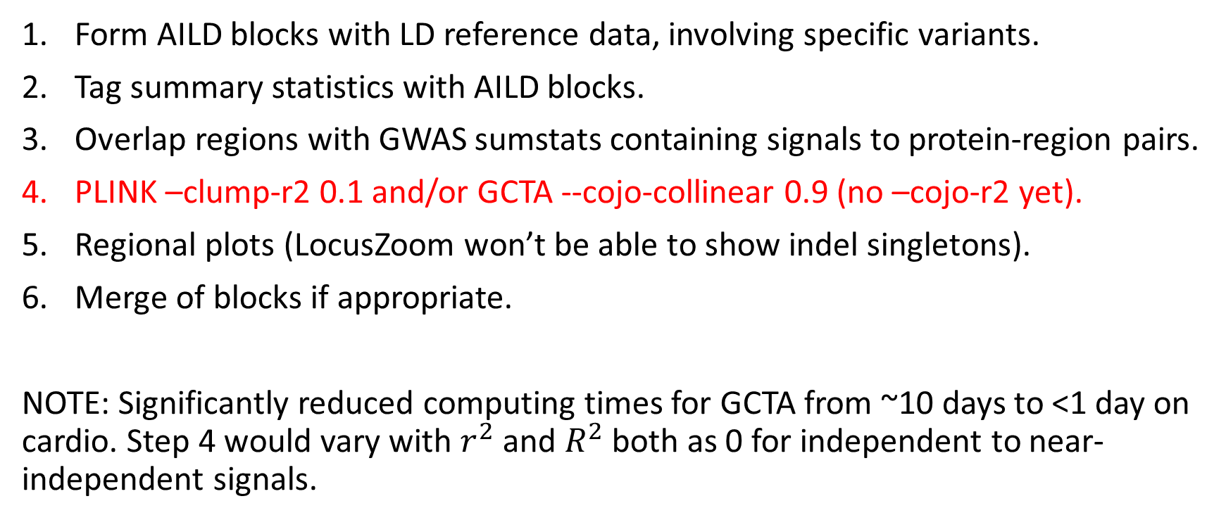
Computationally efficient algorithms
Form AILD blocks with LD reference data, involving specific variants.
Tag summary statistics with AILD blocks.
Overlap regions with GWAS sumstats containing signals to protein-region pairs.
PLINK –clump-r2 0.1 and/or GCTA --cojo-collinear 0.9 (no –cojo-r2 yet).
Regional plots (LocusZoom won’t be able to show indel singletons).
Merge of blocks if appropriate.
NOTE: Significantly reduced computing times for GCTA from ~10 days to <1 day on cardio. Step 4 would vary with $r^{2}$ and $R^{2}$ both as 0 for independent to near-independent signals.

Slide 25
Summary
Correspondence between INTERVAL and INF1 was reassuring over many aspects of the results, in particular cis/trans classification.
Specific findings such as OPG (and also TNFSF14, IL12B) demonstrated the validity and power of the meta-analysis, which will be of interest to advance work in a broad (Sun et al. 2018) and inflammation-specific (Niewczas et al. 2019) contexts.
The website https://jinghuazhao.github.io/INF/ + R/gap package will facilitate analysis inside the SCALLOP consortium and outside.

Slide 26
R/gap functions
invnormal
log10p
gc.lambda
cis.vs.trans.classification
mhtplot.trunc
METAL_forestplot
…
https://github.com/jinghuazhao/R

Slide 27
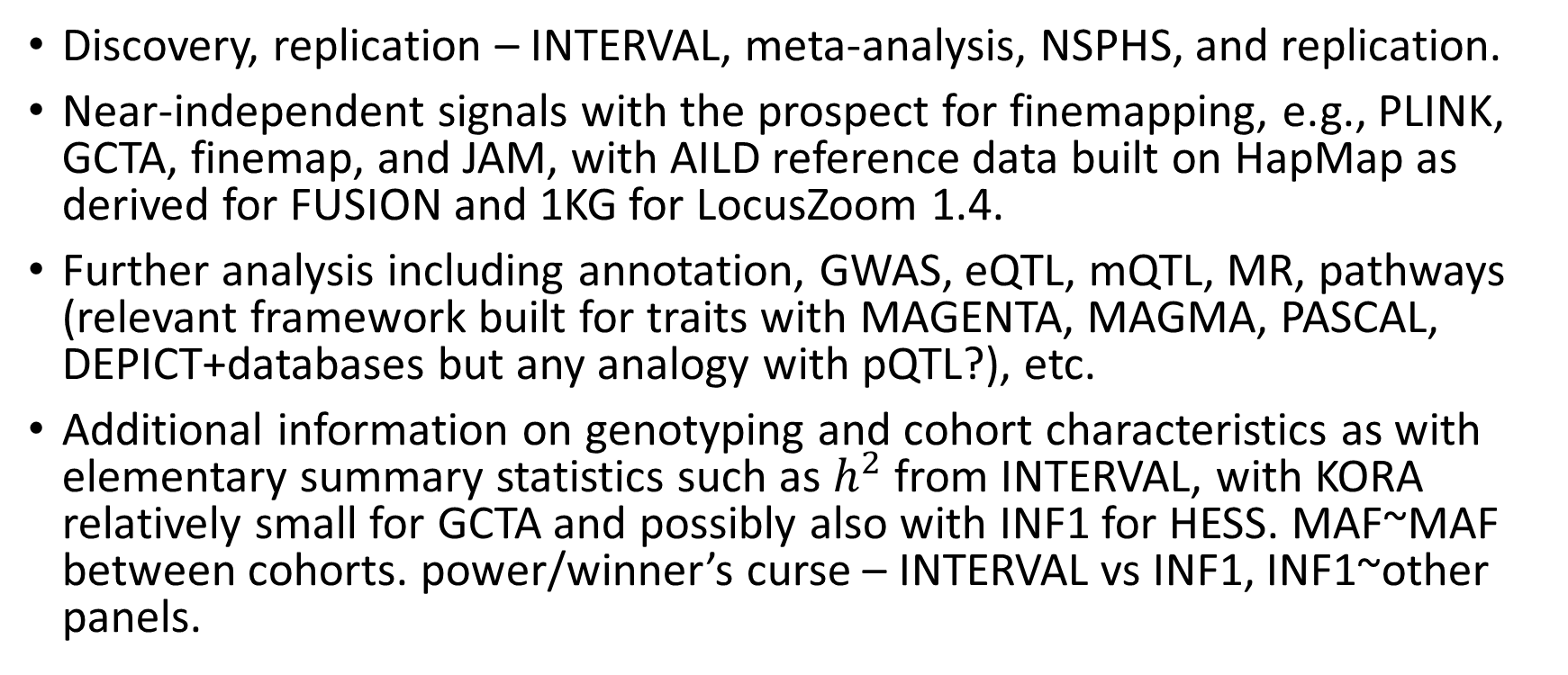
A bird’s eye view
Discovery, replication – INTERVAL, meta-analysis, NSPHS, and replication.
Near-independent signals with the prospect for finemapping, e.g., PLINK, GCTA, finemap, and JAM, with AILD reference data built on HapMap as derived for FUSION and 1KG for LocusZoom 1.4.
Further analysis including annotation, GWAS, eQTL, mQTL, MR, pathways (relevant framework built for traits with MAGENTA, MAGMA, PASCAL, DEPICT+databases but any analogy with pQTL?), etc.
Additional information on genotyping and cohort characteristics as with elementary summary statistics such as $h^{2}$from INTERVAL, with KORA relatively small for GCTA and possibly also with INF1 for HESS. MAF~MAF between cohorts. power/winner’s curse – INTERVAL vs INF1, INF1~other panels.

Slide 28
Landmarks
14/5/19 – AILD results including PhenoScanner v2.
9/5/19 – BHF poster on cis/trans signals and IL.12B.
27/3/19 – cross-reference with INTERVAL on INTERVAL genotype data, which showed great similarity with INF1, esp. w.r.t. cis signals.
8/3/19 – Recognition of MAF cutoff on IFN.gamma, IL.22.RA1, TSLP.
29/11/18 – 22 proteins with busy Manhattan plots.

Slide 29


Acknowledgements
CEU support team and facilities on HPC/cardio.
Jimmy, Adam, Bram.
IT and TRYGGVE.
Lasse, Anders, study PIs, analysts.

Slide 30
References
Ganz P, et al. (2016). Development and risk score for based risk score for cardiovascular outcomes among patients with stable coronary heart disease. JAMA 315:2532-41
Kwan JSH, et al. (2014). Meta-analysis of genome-wide association studies identifies two loci associated with circulating osteoprotegerin levels. Hum Mol Genet 23(24): 6684—93.
Niewczas MA, et al. (2019). A signature of circulating inflammatory proteins and development of end-stage renal disease in diabetes. Nat Med https://doi.org/10.1038/s41591-019-0415-5
Sun B, et al (2018). Genomic atlas of human plasma proteme. Nature 558: 73-9.
Yengo L, et al. (2018). Meta-analysis of genome-wide association studies for height and body mass index in ∼700 000 individuals of European ancestry. Hum Mol Genet 27:3641–3649

